Slide 1


EXPERT
SYSTEMS
DEEP LEARNING

Slide 2

OUTLINE
Introduction
First Expert System
Components
Types of Expert Systems
Applications

Slide 3

INTRODUCTION
The expert system is a computer system that emulates the decision-making ability of a human expert, which aims to solve complex problems by reasoning knowledge
Expert systems are now a crucial subset of artificial intelligence

Slide 4

FIRST EXPERT SYSTEM
DENDRAL : a rule-based program that was used to map the structure of molecules, to help chemists identify unknown organic molecules.

Slide 5
COMPONENTS
KNOWLEDGE AND RULE BASE
INFERECE ENGINE
USER INTERFACE
EXPLANATION SYSTEM

Slide 6

TYPES OF EXPERT SYSTEMS

Slide 7
RULE BASED EXPERT SYSTEM
In a rule based expert system, knowledge is represented as a set of rules.
Any rule consists of two parts: The IF part, called and antecedent (premise or condition) and THEN part, called the consequent (conclusion or action).
IF {antecedent}
THEN {Consequent}

Slide 8
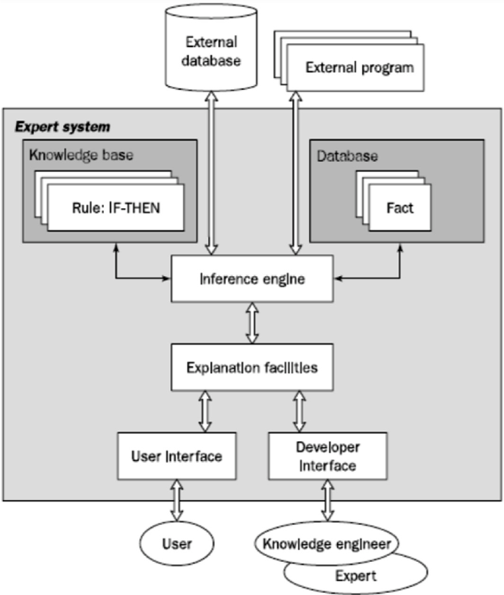
STRUCTURE OF SYSTEM
The knowledge base
The database has set of facts
Inference engine
The explanation facility
The user interface

Slide 9
STEPS
Collect user input
Matching facts with rules
Rule matching and firing
Chaining
Outputting the conclusion

Slide 10
FRAME BASED EXPERT SYSTEM
A frame is a data structure with typical knowledge about a particular object or concept.
The concept of a frame is defined by a collection of slots. Each slot describes a particular attribute or operation of the frame.
A slot may contain a default value or a pointer to another frame, a set of rules or procedure by which the slot value is obtained.

Slide 11
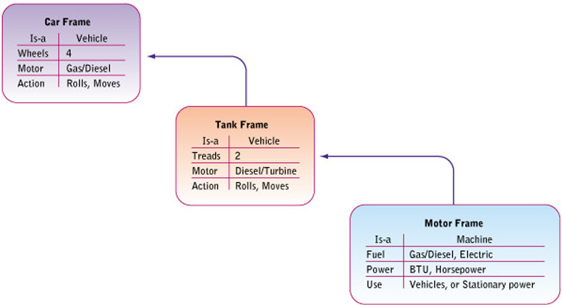
STEPS
Specify the problem
Determine the classes
Define instances.
Design displays
Define when changed methods, and demons.
Define rules.
Evaluate the system.

Slide 12
FUZZY LOGIC BASED EXPERT SYSTEMS
The term fuzzy refers to things that are not clear or are vague.
Fuzzy Logic is a form of many-valued logic in which the truth values of variables may be any real number between 0 and 1, instead of just the traditional values of true or false.

Slide 13
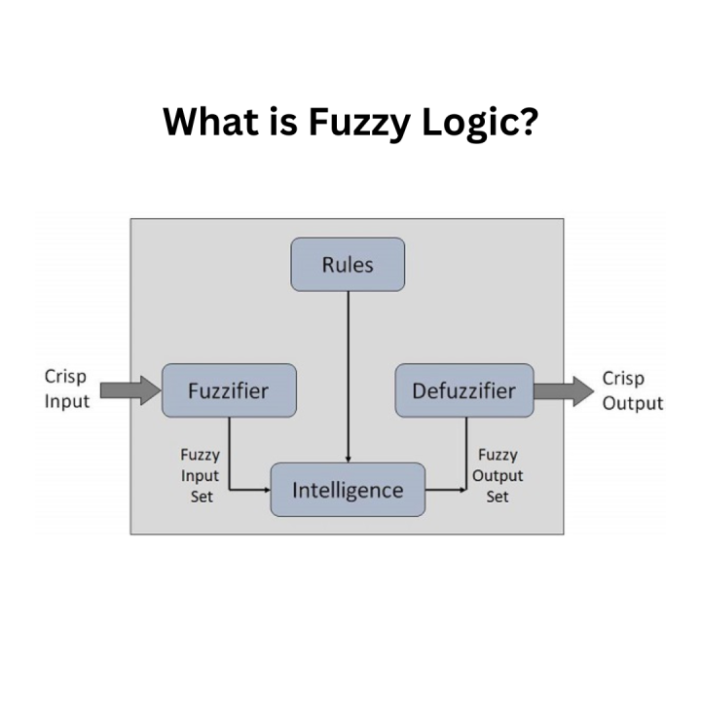
ARCHITECTURE

Slide 14
FLOW
1- Fuzzification: Converting precise (crisp) inputs into fuzzy values using membership functions.
Example: A temperature of 25°C might be 0.7 Warm and 0.3 Cool.
2- Fuzzy Rules: Applying logical rules that use fuzzy sets instead of binary conditions.
Rule: IF temperature is Warm AND humidity is Medium THEN fan speed is Medium

Slide 15
FLOW CONT’D
3- Inference: Determining the degree to which each rule applies, often using min (AND) and max (OR) operations.
Example: If Warm = 0.7 and Medium = 0.1 → Min(0.7, 0.1) = 0.1 → Fan Speed = 0.1 Medium
4- Defuzzification: Converting fuzzy results back into a single crisp output.
The system calculates the weighted average of possible outputs to decide the fan’s exact speed.

Slide 16
NEURAL NETWORK BASED EXPERT SYSTEMS
Neural Network-Based Expert Systems combine the decision-making capabilities of expert systems with the learning and pattern recognition power of neural networks.
Uses a neural network as its inference engine.

Slide 17
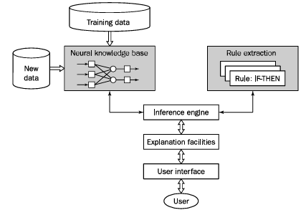
ARCHITECTURE

Slide 18
FLOW
1- Learning Engine: Learns from data by training the model to improve over time.
2- Knowledge Base: Instead of using explicit rules, knowledge is stored as weights in the network.
3- User Interface: Same as traditional systems it interactes with the user to get facts (inputs).
4- Inference Engine: Draws conclusions. The trained neural network processes the input and predicts the most likely output.

Slide 19
BONUS
Explanation Module: Not mandatory, but some systems may incorporate an explanation module for enhanced system interpretability and clarity, as a part of explainable AI. Can be in various shapes:
a- Textual Explanations: Plain text descriptions explaining the system's conclusions or recommendations.
b- Interactive Demonstrations: Allows users to explore the reasoning process interactively.
c- Graphical Representations: Uses diagrams, charts, or graphs to visualize the reasoning process.

Slide 20
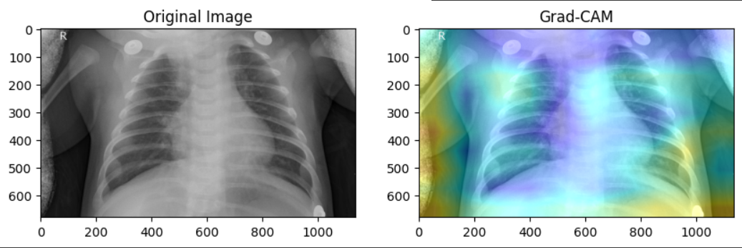
GRAPHICAL REPRESENTATIONS
GRAD-CAM

Slide 21

NEURO-FUZZY LOGIC BASED EXPERT SYSTEMS
NEURO-FUZZY IS A TERM USED TO DESCRIBE A TYPE OF ARTIFICIAL INTELLIGENCE THAT COMBINES ELEMENTS OF BOTH NEURAL NETWORKS AND FUZZY LOGIC.
THE COMBINATION OF THESE TWO TECHNOLOGIES CAN BE USED TO CREATE SYSTEMS THAT ARE MORE FLEXIBLE AND EFFICIENT THAN THOSE THAT USE EITHER TECHNOLOGY ALONE.

Slide 22
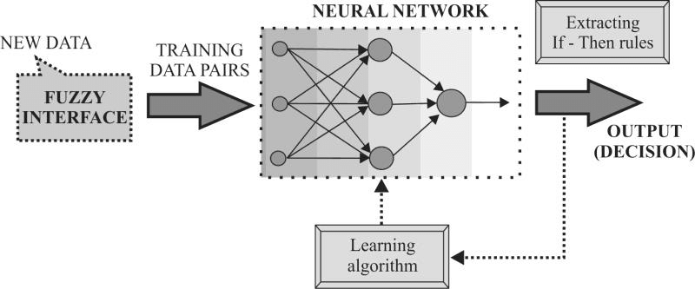
ARCHITECTURE

Slide 23

APPLICATIONS

Slide 24
MEDICAL DIAGNOSIS EXPERT SYSTEM
A huge figure of expert systems is medical. The chief aim of any medical expert system is identification and cure of diseases. A medical expert system is built up of programs and medical knowledge base.
Medical Knowledge:- divided into tow phases
1- Medical conditions of diseases.
2- Deposit of rules

Slide 25
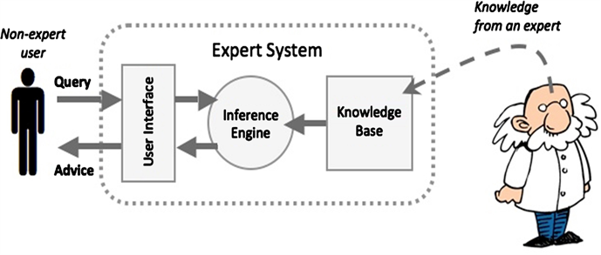
THE STRUCTURE OF MEDICAL
EXPERT SYSTEMS

Slide 26
KNOWLEDGE BASE
Encloses information with reference to diseases which are characterized as a set of if-then production rules.
Example:-
Tuberculosis is a lung disease.
Rule which is as follow:
Disease (Patient, tuberculosis):-
Symptom (Patient, persistent_cough), Symptom (Patient, constant_fatigue),
Symptom (Patient, weight_loss), Symptom (Patient, loss_of_appetite),
Symptom (Patient, fever), Symptom (Patient, coughing_up_blood)

Slide 27
Fact Base:-
Contains facts which are applied to match in opposition to the antecedent part of rules stored in the knowledge base. The fact base is analogue to the instant human memory.
Foremost job of Inference Engine:-
Contains facts which are applied to match in opposition to the antecedent part of rules stored in the knowledge base. The fact base is analogue to the instant human memory.

Slide 28
The User Interface :-
used to correspond among user and expert system.
The Explanation Module permits :-
the user to inquire the expert system how a finicky conclusion is reached and why a specific fact is desired.
The Developer Interface:
used to alter the knowledge base

Slide 29

THANK
YOU

Slide 30
Resources:
1- https://www.geeksforgeeks.org/expert-systems
2- https://www.geeksforgeeks.org/what-are-the-different-components-of-an-expert-system/
3- https://www.techtarget.com/searchenterpriseai/definition/expert-system#:~:text=An%20expert%20system%20is%20a,experience%20in%20a%20particular%20field.

Slide 31
TEAM MEMBERS
1- Amany Alsayed
2- Mariam Wael
3- Sara Ayman
4- Zad Walid

